Slide 1

Hadoop Ecosystem Components and Its Architecture
Dr. Supriya Chakraborty
Notes:
The demand for Big data Hadoop has increased after Hadoop made a special showing in various enterprises for big data management in a big way. Big data hadoop that deals with the implementation of various industry use cases is necessary Understand how the hadoop ecosystem works to master Apache Hadoop skills and gain in-depth knowledge of big data ecosystem and hadoop architecture. It is necessary to get some basic idea on how the hadoop ecosystem works.

Slide 2
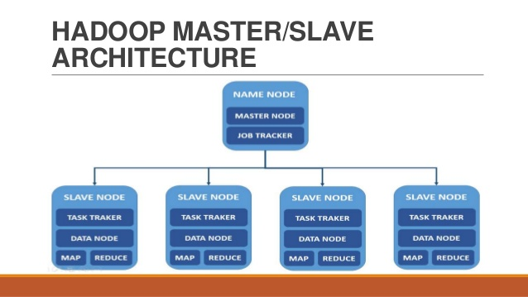
HDFS
Notes:
The default big data storage layer for Apache Hadoop is HDFS. HDFS is the “Secret Sauce” of Apache Hadoop components as users can dump huge datasets into HDFS and the data will sit there nicely until the user wants to leverage it for analysis. HDFS component creates several replicas of the data block to be distributed across different clusters for reliable and quick data access. HDFS comprises of 3 important components-NameNode, DataNode and Secondary NameNode. HDFS operates on a Master-Slave architecture model where the NameNode acts as the master node for keeping a track of the storage cluster and the DataNode acts as a slave node summing up to the various systems within a Hadoop cluster.

Slide 3
What is Hadoop ecosystem?
Hadoop Ecosystem is a platform or a suite which provides various services to solve the big data problems. It includes Apache projects and various commercial tools and solutions.

Slide 4
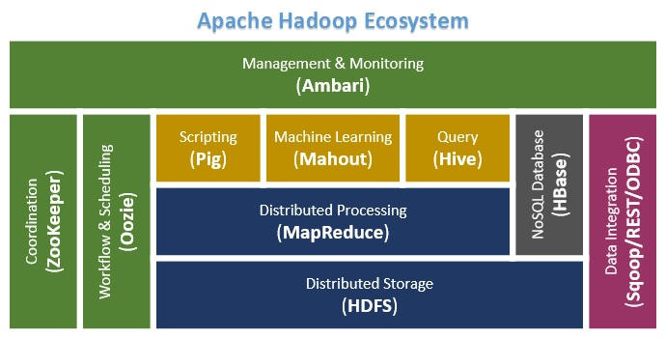

Slide 5
Components of Ecosystem
Hadoop Common
HDFS
Map Reduce
Yarn
Notes:
Significant components of the Hadoop ecosystem are Hadoop Common, Yarn, Map Reduce and HDFS. Each one would be discussed in the successive slides.

Slide 6
Hadoop Common
Apache Foundation has pre-defined set of utilities and libraries that can be used by other modules within the Hadoop ecosystem. For example, if HBase and Hive want to access HDFS they need to make of Java archives (JAR files) that are stored in Hadoop Common.

Slide 7
YARN Architecture
Client
Node
Manager
Resource Manager (RM)
Central Agent- Manages and Allocates
Cluster resources
NodeManager (NM)
Per-Node Agent- Manages and
enforces node resource allocations
ApplicationMaster (AM)
Per-Application –
Manages application
Lifecycle and task
Scheduling
App Mstr
Resource
Manager
Node
Manager
Container
Node
Manager
Notes:
YARN forms an integral part of Hadoop 2.0.YARN is great enabler for dynamic resource utilization on Hadoop framework as users can run various Hadoop applications without having to bother about increasing workloads.
Key Benefits of Hadoop 2.0 YARN Component-
It offers improved cluster utilization
Highly scalable
Beyond Java
Novel programming models and services
Agility
YARN Use Case:
Yahoo has close to 40,000 nodes running Apache Hadoop with 500,000 MapReduce jobs per day taking 230 compute years extra for processing every day. YARN at Yahoo helped them increase the load on the most heavily used Hadoop cluster to 125,000 jobs a day when compared to 80,000 jobs a day which is close to 50% increase.

Slide 8
Map Reduce
Client Code
Master Node
Client JVM
Client JVM
User
Map Reduce
Application
Submit
Function
Job client
Job Tracker
NameNode
Copt job Resources
Send status
of the task
Get input splits
Assign task to
Task Trackers
Shared File System (HDFS) and Resources
Data Node
Run Map
Job or
Reduce
Job
Run Map
Job or
Reduce
Job
Task Tracker
Retrieve job resources
And setup local environment
To run the jobs.
Detail with example will be done later
Notes:
MapReduce is a Java-based system created by Google where the actual data from the HDFS store gets processed efficiently. MapReduce breaks down a big data processing job into smaller tasks. MapReduce is responsible for the analysing large datasets in parallel before reducing it to find the results. In the Hadoop ecosystem, Hadoop MapReduce is a framework based on YARN architecture. YARN based Hadoop architecture, supports parallel processing of huge data sets and MapReduce provides the framework for easily writing applications on thousands of nodes, considering fault and failure management.
The basic principle of operation behind MapReduce is that the “Map” job sends a query for processing to various nodes in a Hadoop cluster and the “Reduce” job collects all the results to output into a single value. Map Task in the Hadoop ecosystem takes input data and splits into independent chunks and output of this task will be the input for Reduce Task. In The same Hadoop ecosystem Reduce task combines Mapped data tuples into smaller set of tuples. Meanwhile, both input and output of tasks are stored in a file system. MapReduce takes care of scheduling jobs, monitoring jobs and re-executes the failed task.
MapReduce framework forms the compute node while the HDFS file system forms the data node. Typically in the Hadoop ecosystem architecture both data node and compute node are considered to be the same.
The delegation tasks of the MapReduce component are tackled by two daemons- Job Tracker and Task Tracker as shown in the image in the slide –
MapReduce Use Case:
Skybox has developed an economical image satellite system for capturing videos and images from any location on earth. Skybox uses Hadoop to analyse the large volumes of image data downloaded from the satellites. The image processing algorithms of Skybox are written in C++. Busboy, a proprietary framework of Skybox makes use of built-in code from java based MapReduce framework.

Slide 9
APACHE PIG
PIG was initially developed by Yahoo.
PIG has two parts: Pig Latin, the language and the pig runtime, for the execution environment. You can better understand it as Java and JVM.
It supports pig latin language, which has SQL like command structure.
10 line of pig latin = approx. 200 lines of Map-Reduce Java code
The compiler internally converts pig latin to MapReduce. It produces a sequential set of MapReduce jobs, and that’s an abstraction (which works like black box).
It gives you a platform for building data flow for ETL (Extract, Transform and Load), processing and analyzing huge data sets.

Slide 10
Thank You
How Pig works?
In PIG, first the load command, loads the data. Then we perform various functions on it like grouping, filtering, joining, sorting, etc. At last, either you can dump the data on the screen or you can store the result back in HDFS.

Slide 11
HIVE
Facebook created HIVE for people who are fluent with SQL. Thus, HIVE makes them feel at home while working in a Hadoop Ecosystem.
Basically, HIVE is a data warehousing component which performs reading, writing and managing large data sets in a distributed environment using SQL-like interface.
HIVE + SQL = HQL ; The query language of Hive is called Hive Query Language(HQL), which is very similar like SQL.
It has 2 basic components: Hive Command Line and JDBC/ODBC driver.
The Hive Command line interface is used to execute HQL commands.
While, Java Database Connectivity (JDBC) and Object Database Connectivity (ODBC) is used to establish connection from data storage.
Secondly, Hive is highly scalable. As, it can serve both the purposes, i.e. large data set processing (i.e. Batch query processing) and real time processing (i.e. Interactive query processing).
You can use predefined functions, or write tailored user defined functions (UDF) also to accomplish your specific needs.

Slide 12
Mahout
Mahout provides an environment for creating machine learning applications. Machine learning algorithms allow us to build self-learning machines that evolve by itself without being explicitly programmed. Based on user behaviour, data patterns and past experiences it makes important future decisions. You can call it a descendant of Artificial Intelligence (AI).

Slide 13
What Mahout does?
Collaborative filtering: Mahout mines user behaviors, their patterns and their characteristics and based on that it predicts and make recommendations to the users. The typical use case is E-commerce website.
Clustering: It organizes a similar group of data together like articles can contain blogs, news, research papers etc.
Classification: It means classifying and categorizing data into various sub-departments like articles can be categorized into blogs, news, essay, research papers and other categories.
Frequent item set missing: Here Mahout checks, which objects are likely to be appearing together and make suggestions, if they are missing. For example, cell phone and cover are brought together in general. So, if you search for a cell phone, it will also recommend you the cover and cases.
Mahout provides a command line to invoke various algorithms. It has a predefined set of library which already contains different inbuilt algorithms for different use cases.

Slide 14
Spark
Apache Spark is a framework for real time data analytics in a distributed computing environment.
• The Spark is written in Scala and was originally developed at the University of California, Berkeley.
• It executes in-memory computations to increase speed of data processing over Map-Reduce.
• It is 100x faster than Hadoop for large scale data processing by exploiting in-memory computations and other optimizations. Therefore, it requires high processing power than Map-Reduce.
Notes:
As you can see, Spark comes packed with high-level libraries, including support for R, SQL, Python, Scala, Java etc. These standard libraries increase the seamless integrations in complex workflow. Over this, it also allows various sets of services to integrate with it like MLlib, GraphX, SQL + Data Frames, Streaming services etc. to increase its capabilities. . Apache Spark best fits for real time processing, whereas Hadoop was designed to store unstructured data and execute batch processing over it. When we combine, Apache Spark’s ability, i.e. high processing speed, advance analytics and multiple integration support with Hadoop’s low cost operation on commodity hardware, it gives the best results.
That is the reason why, Spark and Hadoop are used together by many companies for processing and analyzing their Big Data stored in HDFS.

Slide 15
Apache HBASE
HBase is an open source, non-relational distributed database. In other words, it is a NoSQL database.
It supports all types of data and that is why, it’s capable of handling anything and everything inside a Hadoop ecosystem.
It is modelled after Google’s BigTable, which is a distributed storage system designed to cope up with large data sets.
The HBase was designed to run on top of HDFS and provides BigTable like capabilities.
It gives us a fault tolerant way of storing sparse data, which is common in most Big Data use cases.
The HBase is written in Java, whereas HBase applications can be written in REST, Avro and Thrift APIs.
Notes:
For better understanding, let us take an example. You have billions of customer emails and you need to find out the number of customers who has used the word complaint in their emails. The request needs to be processed quickly (i.e. at real time). So, here we are handling a large data set while retrieving a small amount of data. For solving these kind of problems, HBase was designed.
https://www.tutorialspoint.com/hadoop/hadoop_mapreduce.htm

